Slide 1
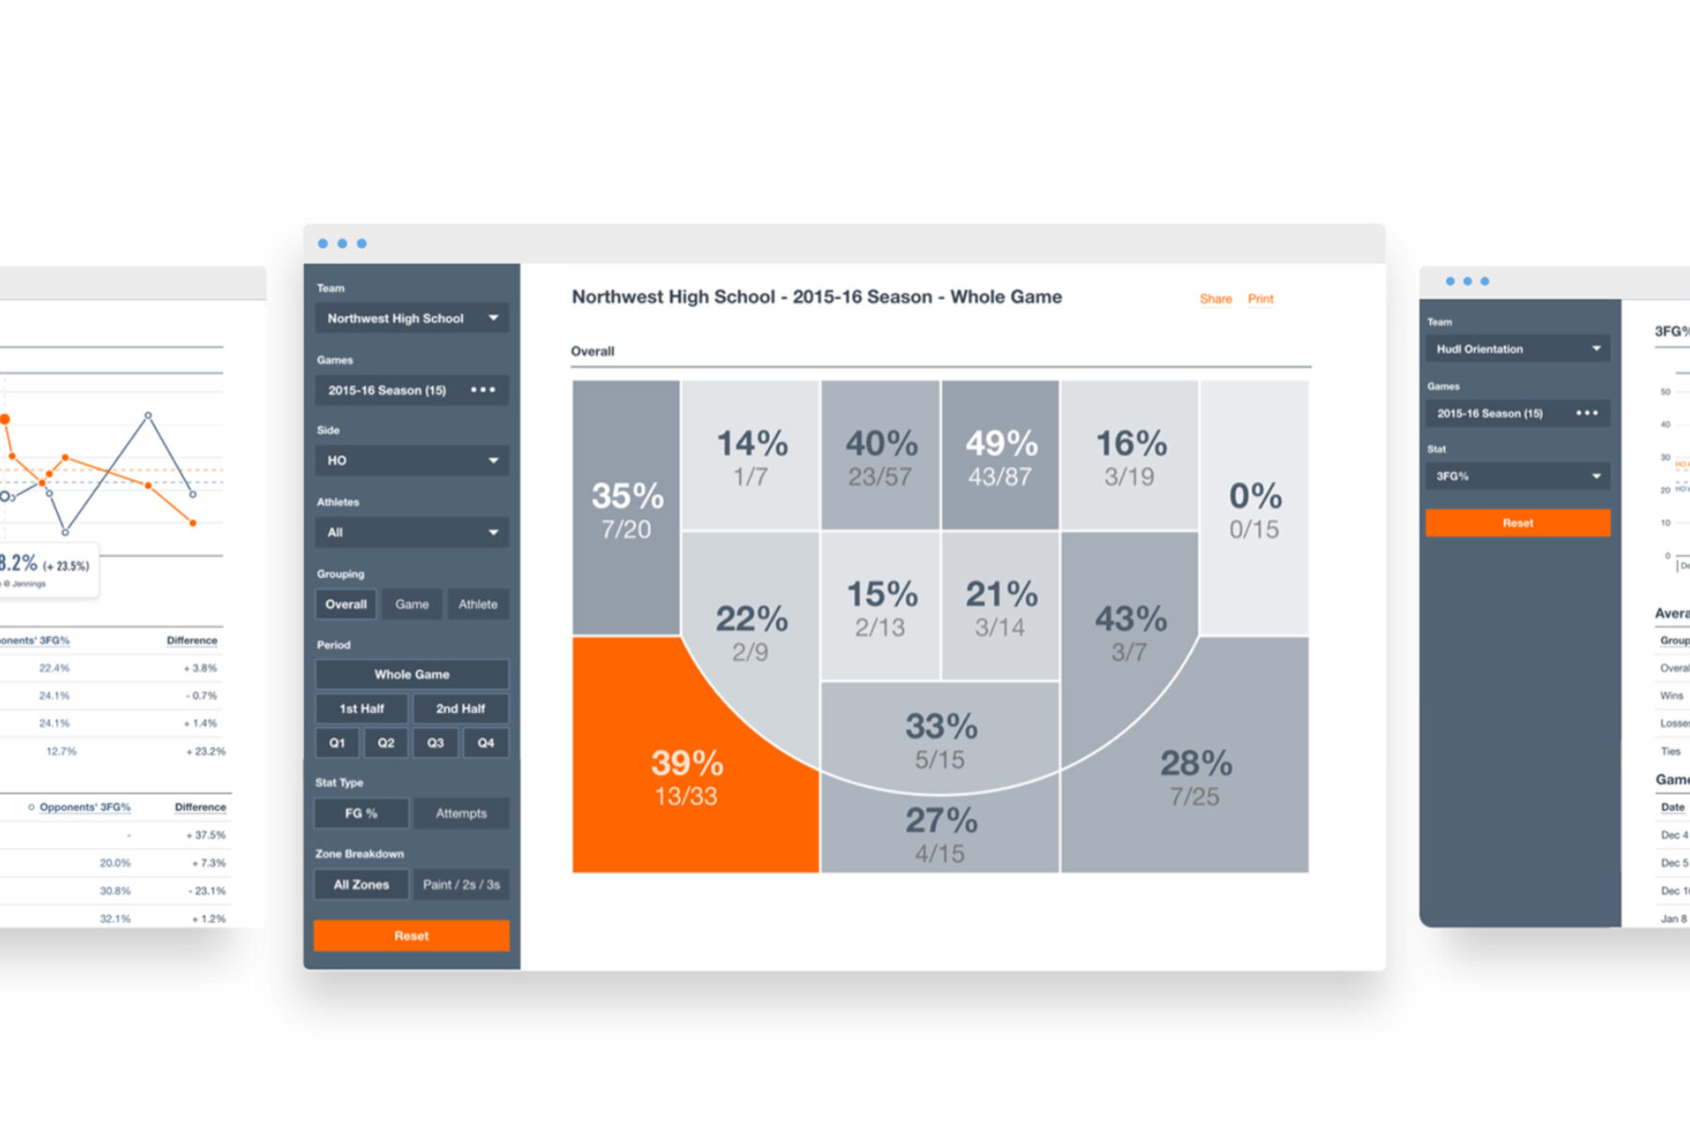
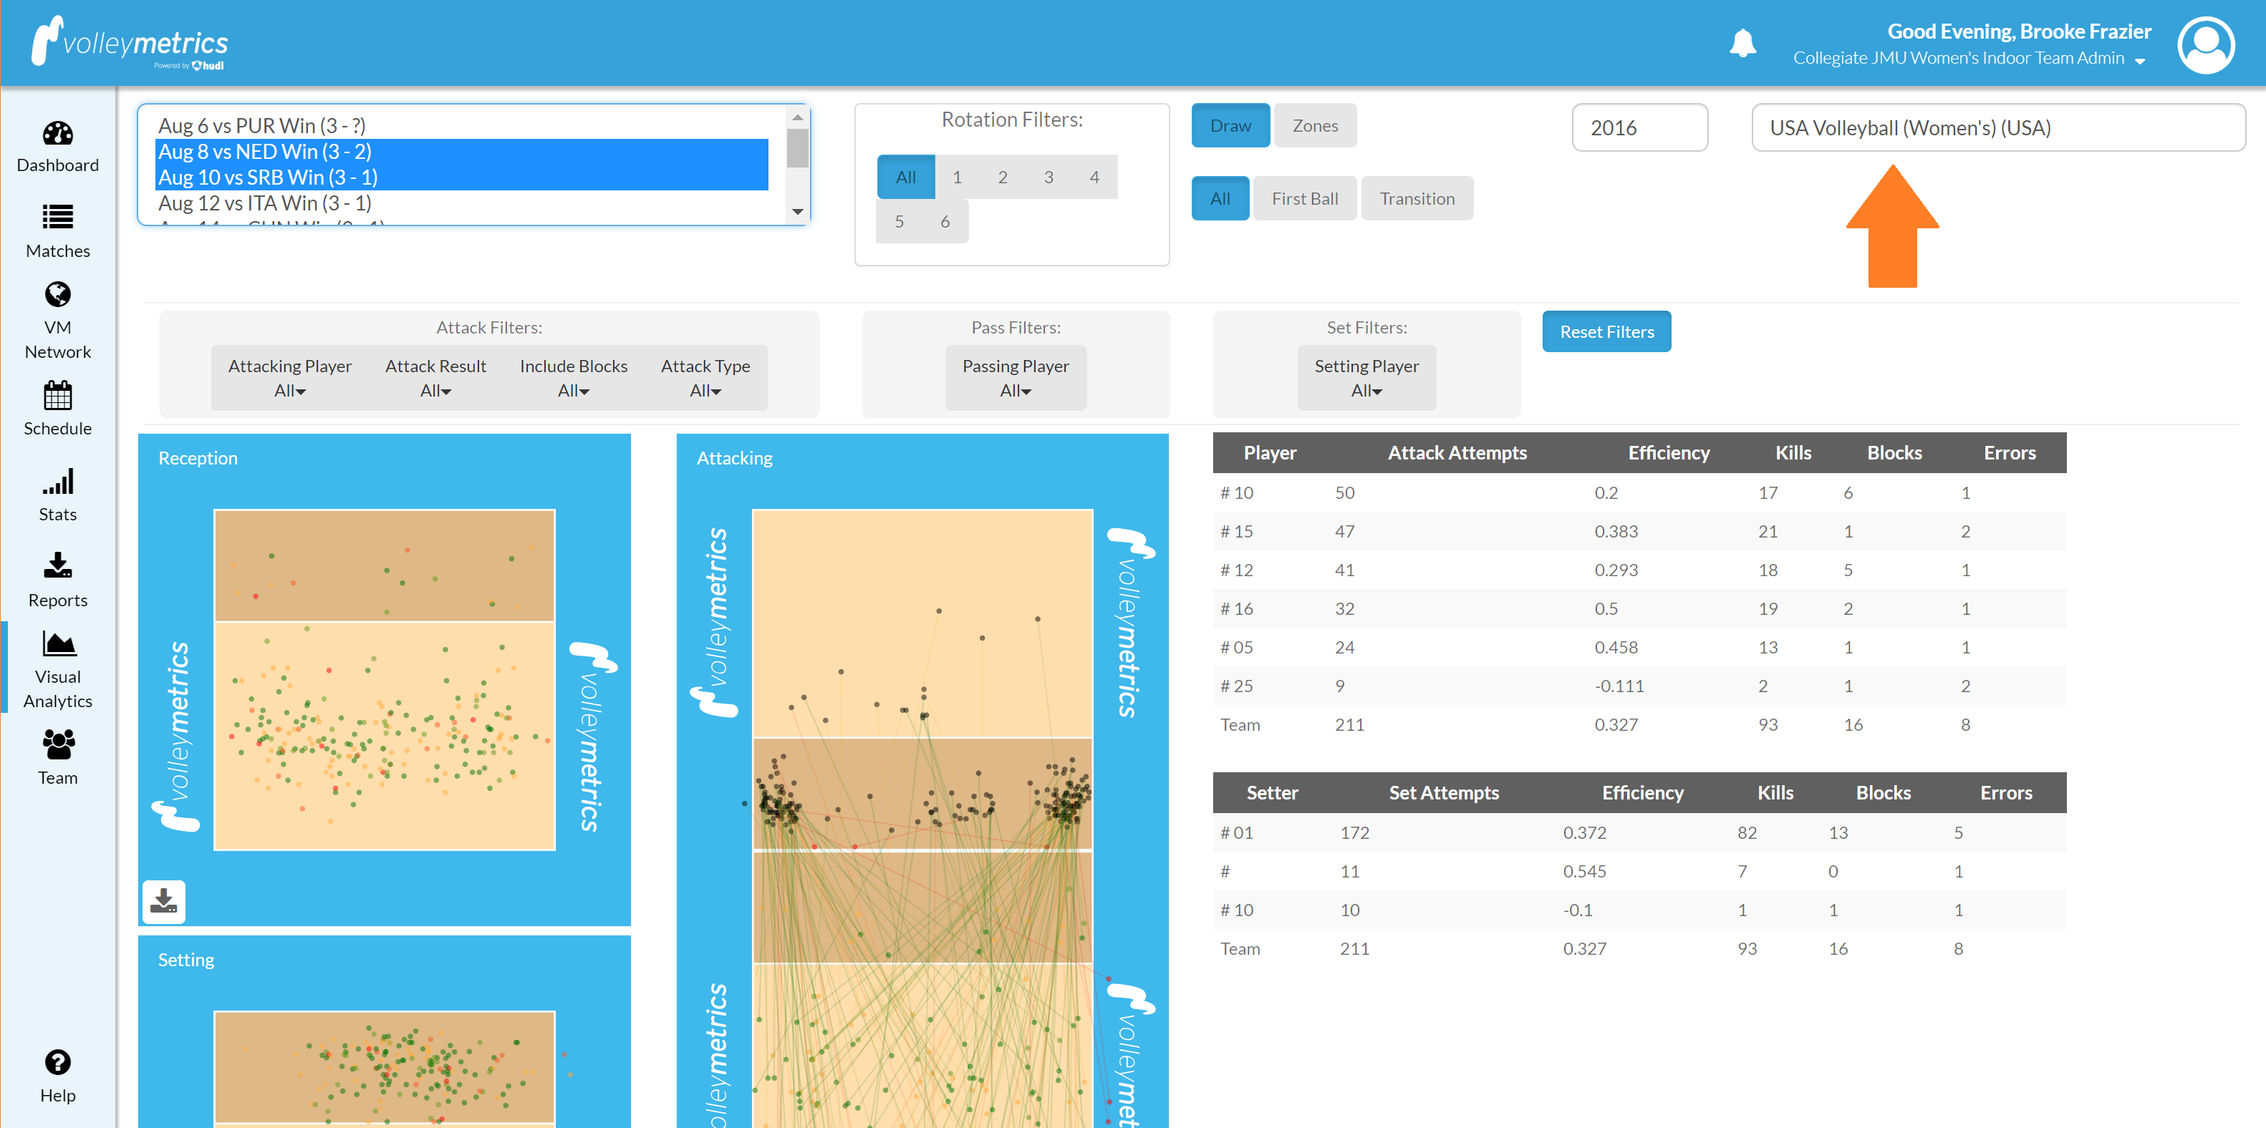
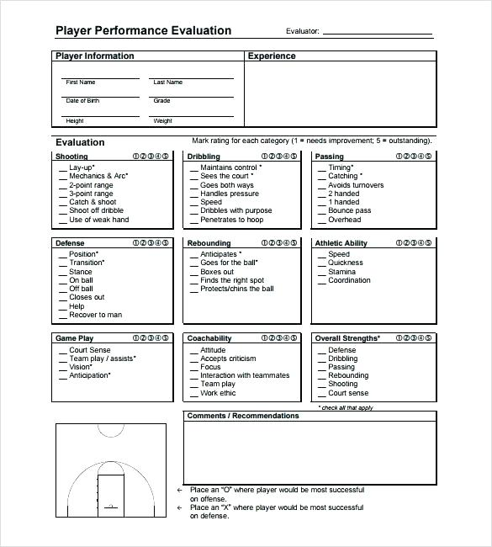
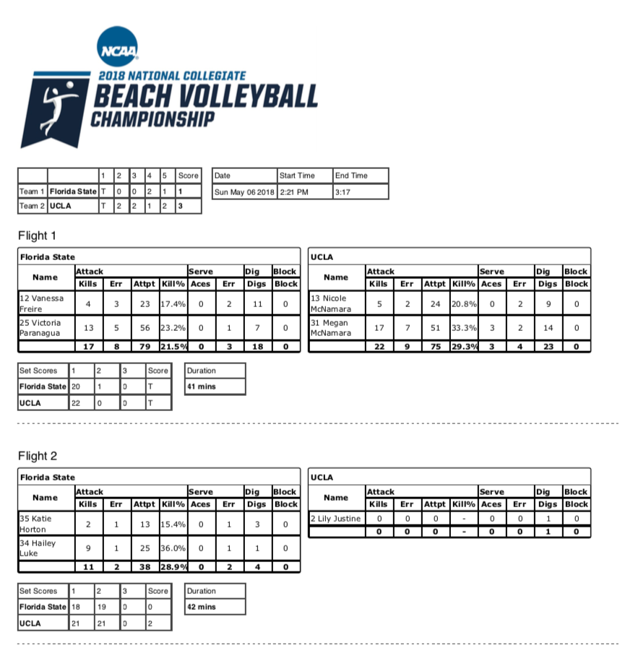
An Examination into Effective Interactive Dashboard Design Usability and Adaptability in Collegiate Sports - a Journey from Paper Printouts to Online Dashboard Usage
Denise R. Bradford, M.S.^{1,2,3}, Brad Smith, M.S.^{1,2}, Susan R. VanderPlas, PhD^{1,3}
University of Nebraska – Lincoln¹; Nebraska Performance Athletic Lab (NAPL⁾ ² ; Department of Statistics³
Abstract
This examination aims to review and compare analytical dashboards used by the collegiate coaching staff and identify similarities and differences in design, format, scope, and adaptability. We reviewed design features of dashboards used in 5 different sports on coaching staff with high expectations to no expectations. The results will show heterogeneity in format and scope of outcomes in dashboards. Generally, sports varied in their use of features, style of color coding, and data usage for displayed metrics. For example, the number of features per dashboard ranged from 4 to 10 from 2-5 data sources ranging from open source to private APIs. Given the considerable variation in dashboard design and data usage, there is a need for future work to assess the fundamental key performance features to scope for the best outcomes. Finally, to identify specific elements that contribute to adaptability and usability to help customize dashboards to meet the expectations of different sports and coaching staff.
Challenges
Effective Game Reports are a subjective assessment Coaching staff know what they want and have no way of communicating the needs. Ineffective Products will not be used and overlooked There are objective measures of things that contribute to useful metrics available in public datasets. Typically, coaching staff/ scouting departments in collegiate sports are managed by a few part-time employees or volunteers. In some cases, essential staff are full-time employees, but still, the dashboards we are interested in do not have sufficient funding to hire professionals to gather and analyze data.
Project Questions
How do we leverage data science and exploratory data methods to inform coaching staff to reduce the manual aspects of game reports and maintain reliability? How does an interactive dashboard of open-source data integrate into overall decision-making? Can we focus on estimating only things that objective measurements don't capture?
Why Use Dashboards?
Audience: As small colleges and universities traditionally do not have access: Data scientists/Data Analysts Ability to easily leverage data collected publicly to support decisions Our research will provide a framework with data about particular sports services to develop strategies to improve the quality of effective game reporting for their players. Visualization Goals: Create a central place for the excess data to be conveyed in a single comprehensive visual. Create a sport-specific feature (graph/chart) that will allow the coaching staff to understand the essential use of the product. Add an overview of sport general basics related to the sports standard box scores/metrics. Engage People: We will assess our visualizations to determine which strategies for user interface and interactive graphics design are most useful to empower coaching staff to make discoveries in publicly available data assembled with a focus on items that impact team wins.
Future Work
Identify Guiding Design Principles Define and Identify Design Workflow Methods Feedback Loop
Basic Idea
Assemble publicly available data sets with privately available data sets Assess usability, interpretability, and adaptability to new statistical methodology. Colligate Sport dashboard incorporates two major components: - Data Visualization Interface component - Data Summaries The Collegiate dashboard data are primarily assembled from open source data, such as ESPN, NCAA Stats, and R packages, with some additional datasets assembled from third-party APIs and private sources, such as coaching staff. Most of these data sets are collected at a game or player resolution, requiring us to carefully join data to ensure that these differences are respected while collating relevant information at the season level. In some cases, unique datasets are collected to understand the game play /self-scouting of their respective teams.
References
SoloStats – Rotate 123 (2020). NCAA Volleyball. https://www.solostatslive.com/ncaa-beach-championships---solostats-touch.html Accessed: 2021-08-01. https://www.swiftsparks.com/scouting-report-template-basketball/scouting-report-template-basketball-15/ Accessed: 2021-10-12. https://www.hudl.com/support/volleymetrics/stats-and-reports/visual-analytics-1/navigate-the-visual-analytics-page Accessed: 2022-02-14. https://thevi5ion.wordpress.com/2018/12/11/college-basketball-player-analysis-tableau-dashboards/ Accessed: 2022-02-14.
Dashboard Needs
Sport | Requested
Men’s Basketball | Yes
Women’s Basketball | No
Football | Yes
Volleyball | No
Softball | No
Dashboard needs seem to be more requested by those with the bandwidth and resources, but our work looks to help change this for all collegiate sports.
QUESTIONS?
If you have questions, we’re here to help! Denise.bradford@huskers.unl.edu

